Slide 2
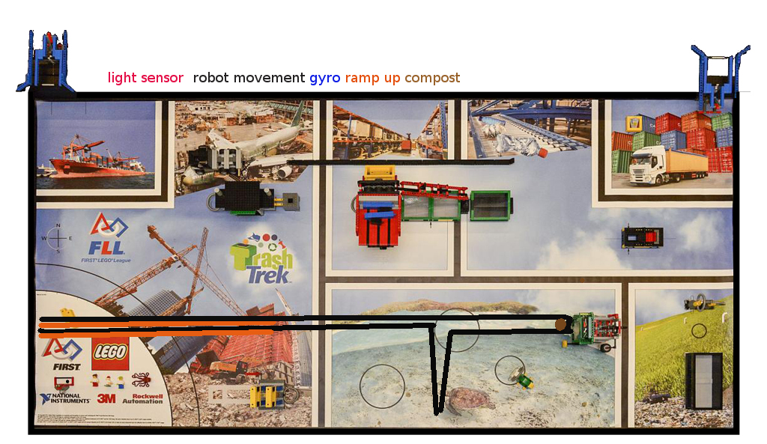
Get Compost

Slide 3
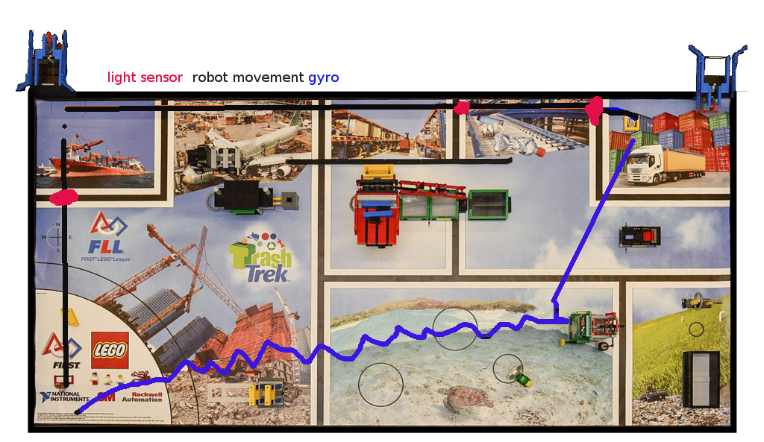
Push Truck Grab FAR Toy

Slide 4
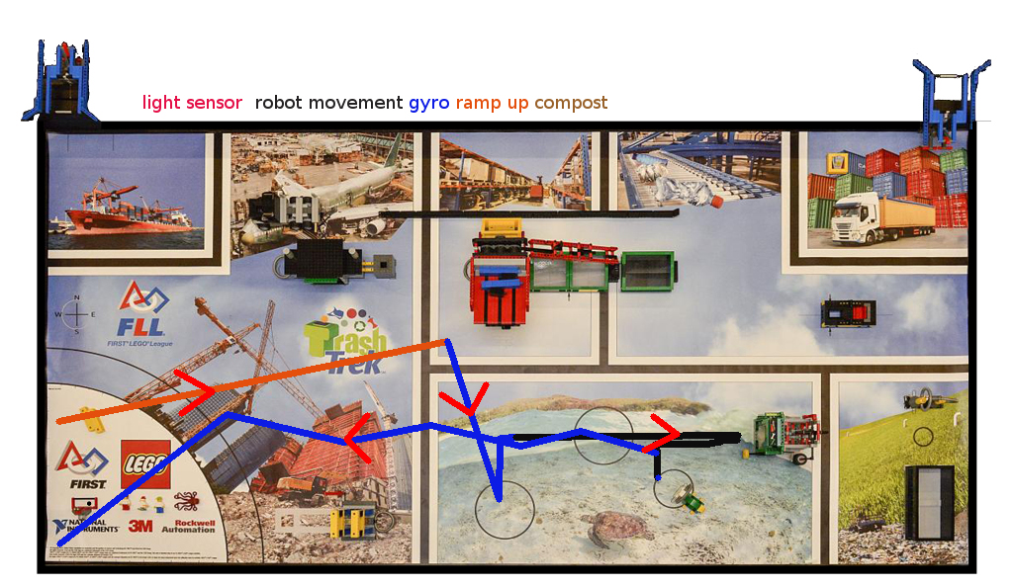
Career/Animals/Push Compost/Grab Bag

